Slide 1


“Superstripes 2023”
Ischia, 26 June 2023
Floquet generation of topological superconductivity
and magnetism in the strong-correlation regime
Hideo Aoki
Dept Physics, Univ Tokyo, Japan

Slide 2
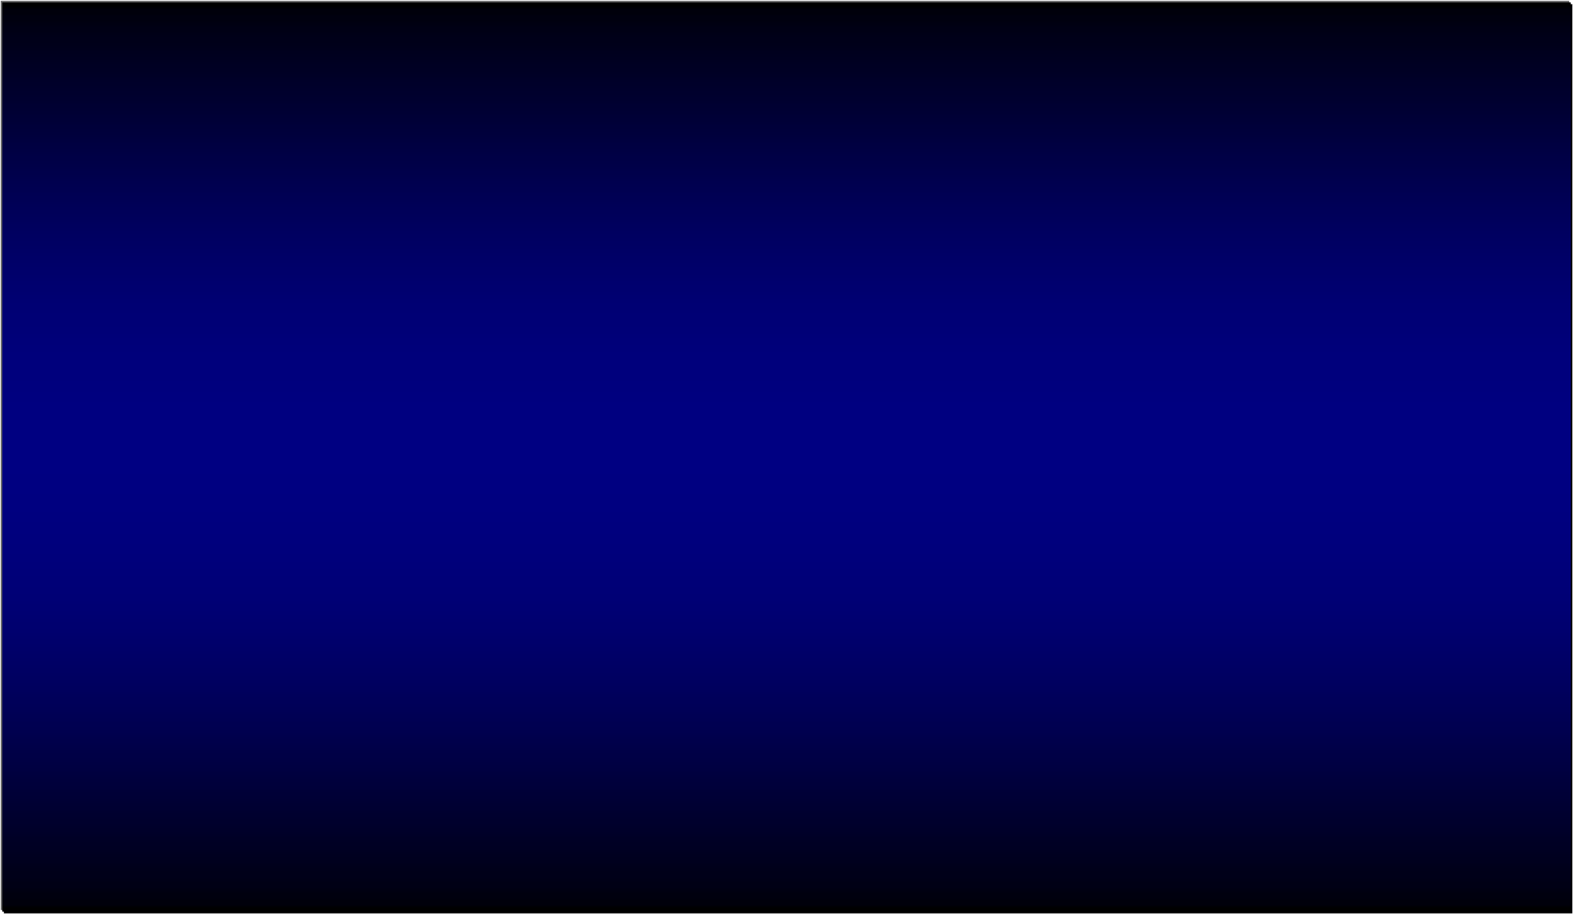
How to realise a topological SC
In equilibrium, requires a special class of materials, etc
gap f
t → -t
(d+id): BdG class C (top # = 2ℤ for d =2)
in the classification table for topological systems
(Altland-Zirnbauer 1997; Ryu, Furusaki, ...)

Slide 3
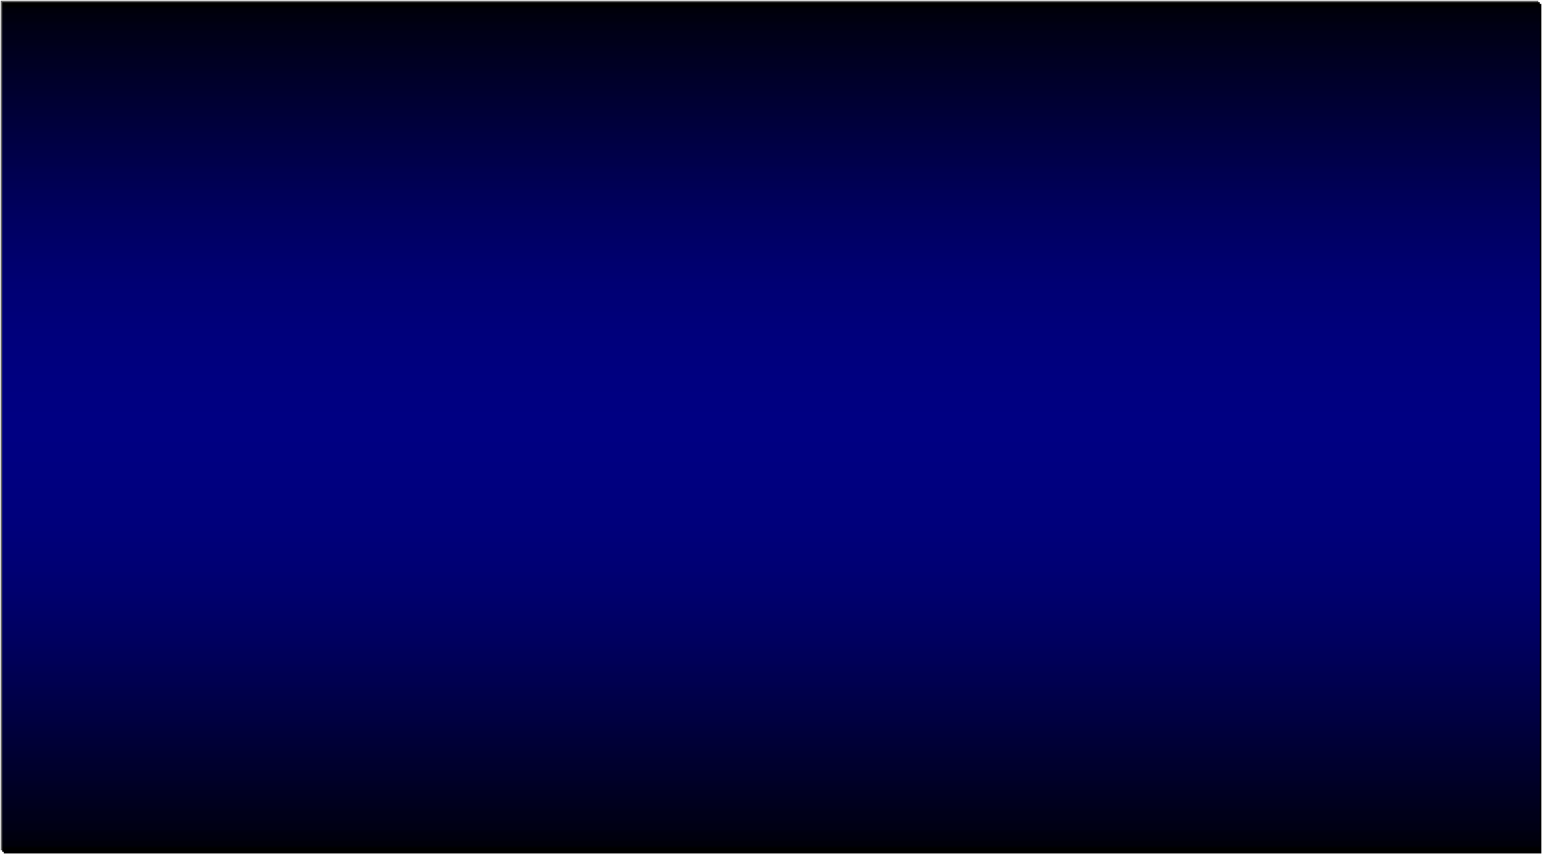
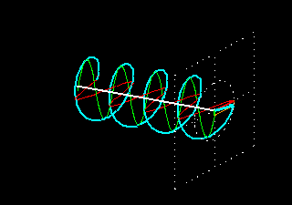

Use non-equilibrium, ie, Floquet engineering
circularly-
polarised light
d-wave SC
phase of Δ
but this requires strong correlation (since light does not directly couple with Δ)
(d+id)-wave SC

Slide 4

Shine a laser: Floquet physics ― as one-body effect
(Oka & Aoki, PRB 2009)
Experimental detection of FTI in graphene
(McIver et al, 2020)
Floquet topological insulator
(in B = 0)
topological gap opens
dynamically
Quantum anomalous Hall
Chern density
Non-interacting band engineering

Slide 5

"Floquet engineering in the strong-correlation regime"
One-body physics Many-body physics
graphene → FTI
d-wave SC →(d+id)-wave
(Oka & Aoki, PRB 2009)
(Kitamura & Aoki, Comm Phys 2022)
* Can we readily extend this to SC?
-- no, not readily, since Δ does not couple with laser in linear resp
but we can propose to go to strong-correlation regime (higher order in 1/U ) → interactions modified

Slide 6
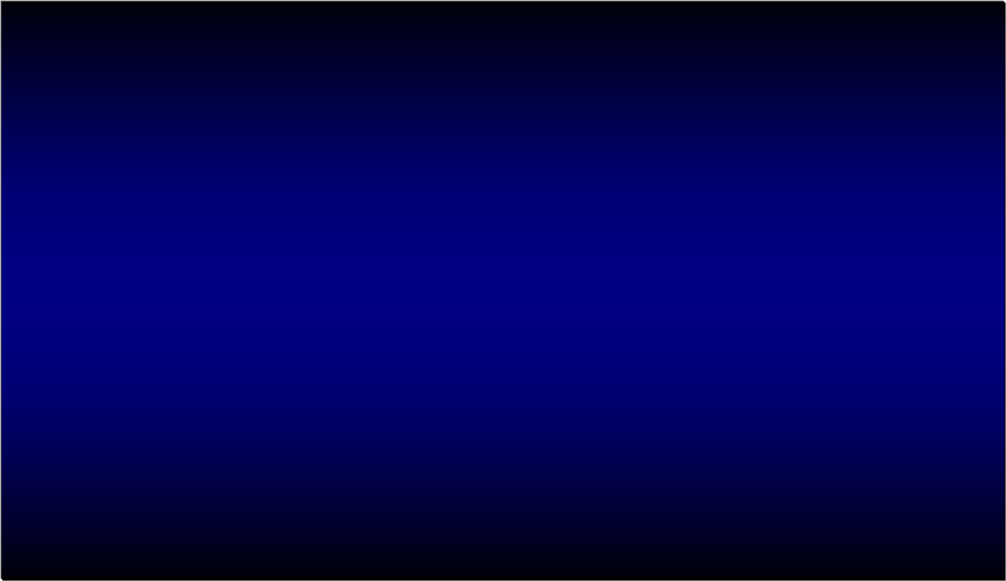
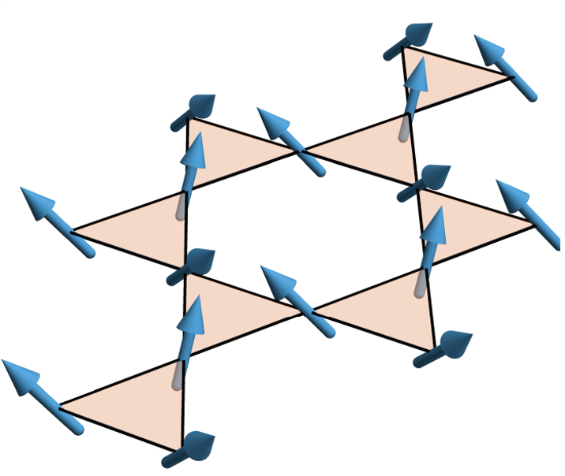
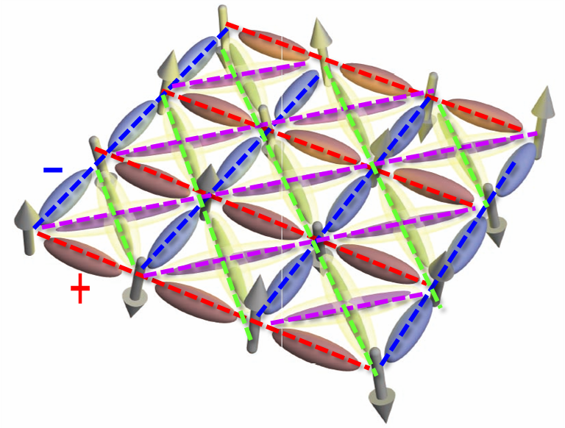
Floquet engineering in the strong-correlation regime
Magnetism in Mott insulator Superconductivity
(from repulsion)
imaginary
Chiral 3-spin interaction
Multi-site photon-induced pairing interactions
(Kitamura, Oka & Aoki, PRB 2017;
Claassen et al, Nat Comm 2017)
(Kitamura & Aoki, Comm Phys 2022)
Floquet-engineered MI
Strong-coupling Floquet engineering

Slide 7
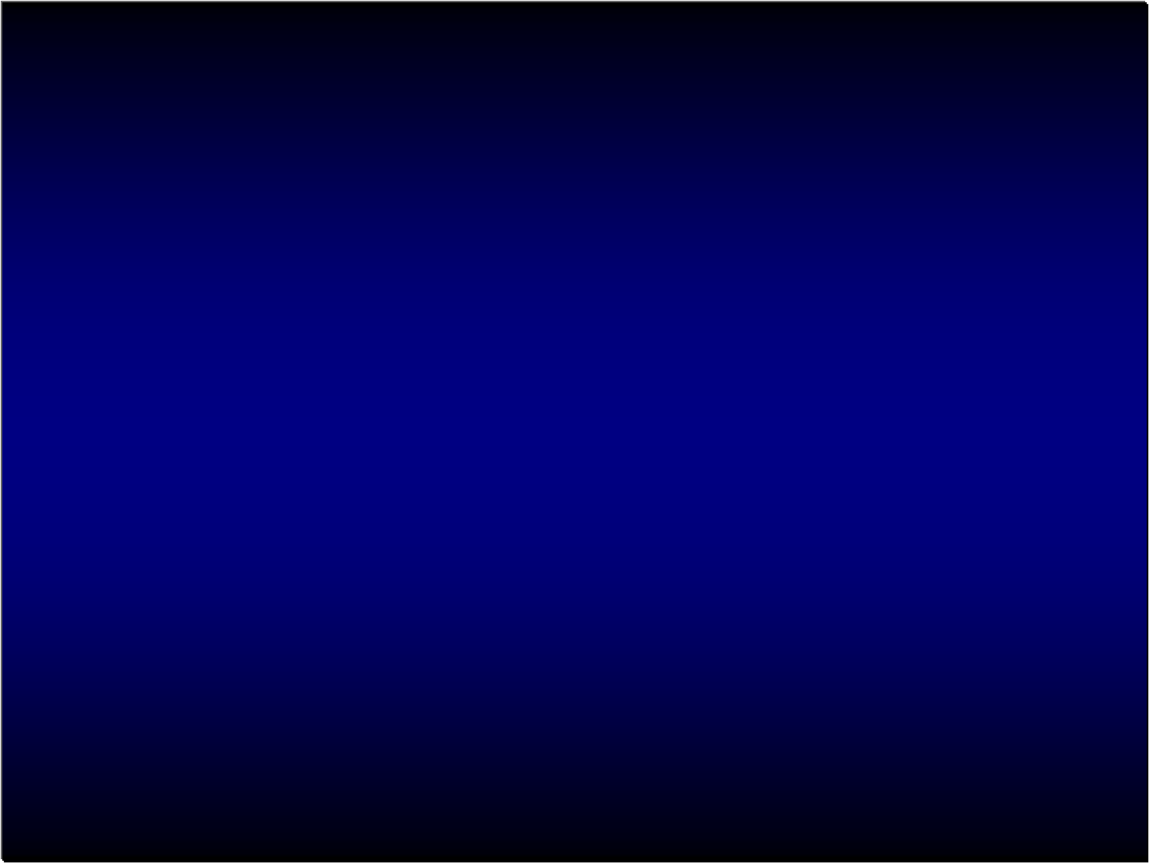
Floquet + Hubbard → various energy scales
U
t
U =0
t
<<
Conventional high-freq(1/ω) expansion
↑ only valid for ω >> U (∼ several eV)
ω =0 U
t
<<
→ Conventional strong-coupling(1/U ) expansion
on-resonant with Hubbard (ω ∼ U )
ω ≠0 U ≠0
t
<<
(Kitamura, Oka & Aoki, PRB 2017)
This can be shown to realise d+id.
Resonance acts to reduce the required laser intensity

Slide 8

(Kitamura, Oka & Aoki, PRB 2017)
Near resonance ω ∼ U
ω
ω
Strong-coupling (1/U ) expansion
+ expansion in 1/ω (ω≲ U )

Slide 9

Resulting Floquet spin Hamiltonian
(Kitamura, Oka & Aoki, PRB 2017)
4th-order strong-coupling (1/U ) + high-ω expansions results in
H_{eff}
✔ Scalar spin-chiral coupling emerges
* Coefficient J χ exhibits resonances against (U , ω)
cyclic (3-site) permutation operator

Slide 10
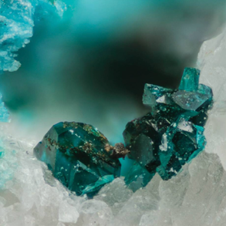
✔ A possibility of chiral spin liquid
in eg herbertsmithite (Norman, RMP 2016)
ZnCu₃(OH)₆Cl₂, GaCu₃(OH)₆Cl₂
(with U/t ∼ 20 Mazin et al, Nat Commun 2014)
and more recently in eg FeSn, LaRuSi, ...

Slide 11
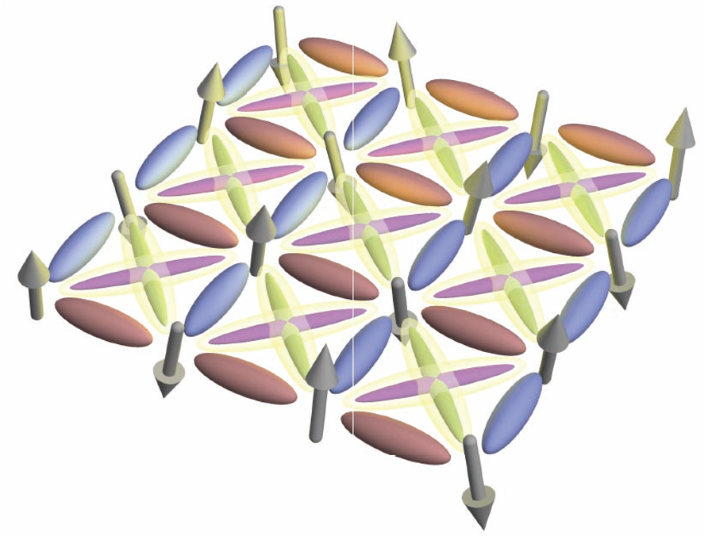
Floquet engineering in the strong-correlation regime
Magnetism in Mott insulator Superconductor
(from repulsion)
-
(a) This way we can evade the difficulty:
Laser has no direct coupling with
the gap f (on linear-resp level)
a key: multi-photon, T-broken interactions
+
imaginary
‹c_{i}c_{i+nn}›: dx²-y²-wave
+i‹c_{i}c_{i+diagonal}›: idxy-wave
Chiral (3-)spin interaction
Diagonal (2nd-neighbour) pairing
(b) We can also utilise the chiral spin coupling.
(Kitamura & Aoki, Comm Phys 2022)
Floquet-engineered MI
Floquet-engineered topological SC

Slide 12
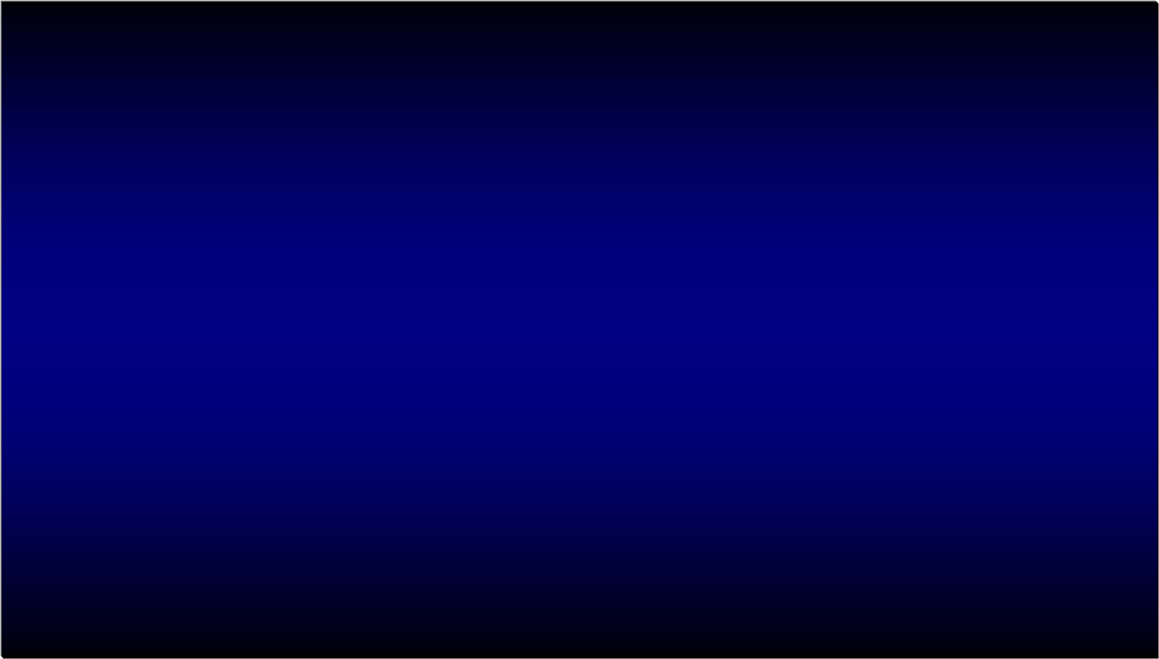
* Let's elaborate why we cannot readily have Floquet SC,
where Δ (electrically neutral) does not directly couple with laser
When we apply Floquet,
A does not modify F
That's why Floquet top SC proposals have so far concentrated on engineering
normal BdG elements → matrices by introducing eg Rashba spin-orbit coupling
(Takasan et al, PRB 2017).
This is interesting, esp for multiband systems, but would complicate the matter
(i.e., SC tends to be nontrivial even before laser illumination, etc).
By contrast, we propose here to use photon-induced interactions
(higher order in 1/U ) in strong correlation w/o a need to modify normal part
(Kitamura & Aoki, Comm Phys 2022)

Slide 13

d-wave SC
d-wave SC
circularly-
polarised light
(d+id)-wave SC
(d+id)-wave SC
(Kitamura & Aoki, Comm Phys 2022)

Slide 14
Let's elaborate d-wave SC + CPL in strong-coupling regime
(Kitamura & Aoki, Comm Phys 2022)
✓ Repulsive Hubbard model + CPL
on a square lattice
t << U → * No CPL → t-J model [strong-coupl (Schrieffer-Wolff)expansion]
* Under CPL → Floquet extension (for t << ω < U )
t
t'
~
photon-induced correlated hopping
photon-modified kinetic exchange
Gutzwiller
projection
Floquet renormalised hopping
photon-induced chiral
spin coupling

Slide 15
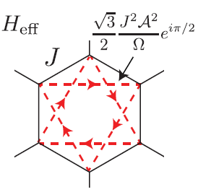
One-body problem
Haldane's model
with imaginary t
honeycomb
t
+ =
this is why honeycomb (eg graphene ) needed for FTI
Strongly-correlated case
square lattice already
accommodates topology
square
no cancellation
cancellation
(Kitamura & Aoki, Comm Phys 2022)

Slide 16
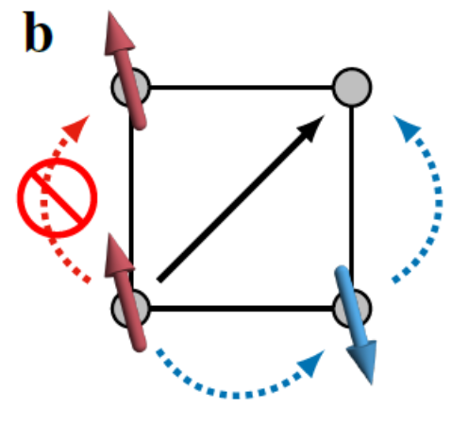

Floquet Hamiltonian in Bogoliubov-de Gennes form
Mean-field analysis for H _{Floquet} with Gutzwiller projection
(Kitamura & Aoki, Comm Phys 2022)
t
t'
∝
f : dx²-y², g: dxy
acquires a d_{xy} component ∝ i γδ sin(k_{x})sin(k_{y}) involving
two-step correlated hopping
chiral spin-coupling
dx²-y² + idxy
pairing interaction

Slide 17
Gap function (dx²-y² + idxy)
(Kitamura & Aoki, Comm Phys 2022)
amplitude phase
=
U = 12t₀ , t'= -0.2t₀, doping=0.2
ω = 1.7t₀ =
slightly red-detuned from U/6
topological gap

Slide 18

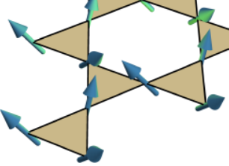
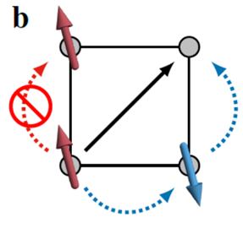
Chiral spin-coupling
Two-step correlated hopping
involving E denominators & Bessel fs
diverges for ω → U/2, U
"ω-U " resonances @ U =ω/integer
peaked along ω=0.4E
diverges for ω → 0, U/2
Large γ occurs even around ω ∼ 0
→ small E ≈ 2.5ω suffices
(t' = -0.2t, U = 12t, δ = 0.2)
laser field intensity
laser frequency
(Kitamura & Aoki, Comm Phys 2022)

Slide 19
(Kitamura & Aoki, Comm Phys 2022)
Two-step correlated hopping Chiral spin-coupling
γ
Jχ
red-detuned from ω = U
laser frequency ω
red-detuned from ω = U/2
Jχ
γ
red-detuned from ω-U resonance → enhanced AF
blue-detuned from ω-U resonance → enhanced F
laser field intensity E
laser field intensity E

Slide 20
Various photon-induced interactions behave as:
two-step correlated hopping
(Kitamura & Aoki, Comm Phys 2022)
γ: J₂(Ea/ω)'s×(ω-U resonance factor),
peaked around E ∼ 2ω/a against E, diverges for ω → 0 or U/2
☺ γ is significant even in low-ω regime, which helps required E ∝ ω
Taylor-expand in E → γ ∼ t t' E⁴ × (function of ω, U )
chiral spin-coupling
J_{χ}: J_{m}(Ea/ω)'s×(ω-U resonance factor),
☺ J_{χ} becomes significant (diverges) for ω → U
Taylor-expand in E → J_{χ} ~ (t t' )² E⁴ × (function of ω, U )
t-t' model needed
kinetic exchange (photon-assisted)
J: strongly-enhanced AF when slightly red-detuned from U/2 or U
For an optimal E , idxy component = i 0.3t sin(k_{x}) sin(k_{y}),
☺ remarkably ≈ dx²-y² = 0.7t [cos(k_{x}) -cos(k_{y})] → large topological gap

Slide 21

"Tc dome" against laser intensity for the (d + id) SC
|Δ|
Im Δ
When we start from T >Tc, T^{eff} plunges into Tc dome
CPL-incuded SC
---:
T ^{eff} in Floquet Hamiltonian
SC
When we start from T<Tc, T^{eff} remains
below Tc dome.
topological
temperature
laser field intensity
(Kitamura & Aoki, Comm Phys 2022)

Slide 22
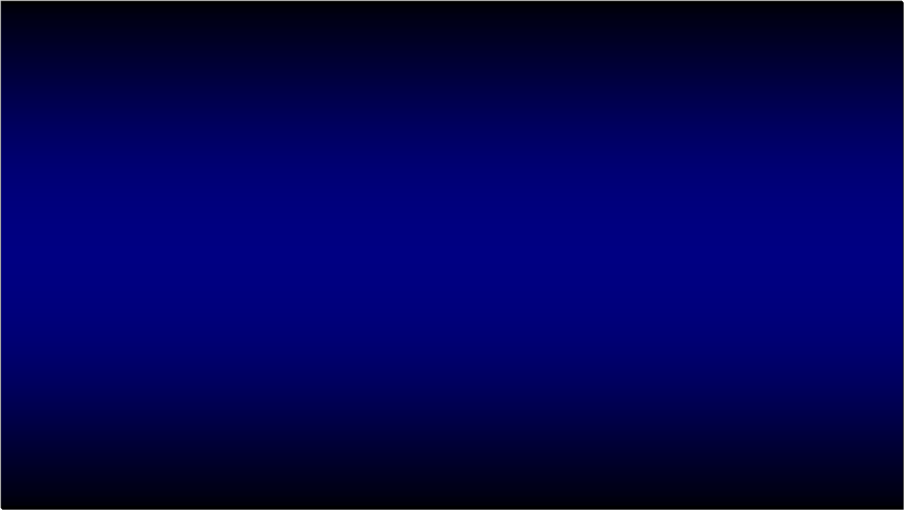
Equilibrium: T-broken SC ← coexisting pairing symmetries
s+id in iron-based SCs
d+id in hexagonal β MNCl (M=Hf, Zr)
(Kuroki, PRB 2010)
(Lee, Zhang & Wu, PRL 2009 for "1111";
Fernandes & Millis, PRL 2013 for "122")
+
+
+ e^{iπ/3}
+ e^{i2π/3}
s+- d
-
-
T
SrPtAs (Fischer et al, PRB 2014)
・ ・ ・
Floquet topological SC ← dynamical & in-situ
(where you can start from a uni-component d-wave,
in non-hexagonal systems)

Slide 23
a sudden switch-on at t = 0

Slide 24
Quench dynamics
confirms CPL-induced SC
|Δ|
Im Δ
oscillation = Higgs A_{2g} mode
noneq-induced SC
(imaginary part)
noneq-induced SC
|Δ|
Im Δ
Switch on
the laser
oscillation = Higgs A_{2g} mode
Switch on
the laser
time
time scale for damped osc ∼ 1/(gap f)
(Kitamura & Aoki, Comm Phys 2022)

Slide 25
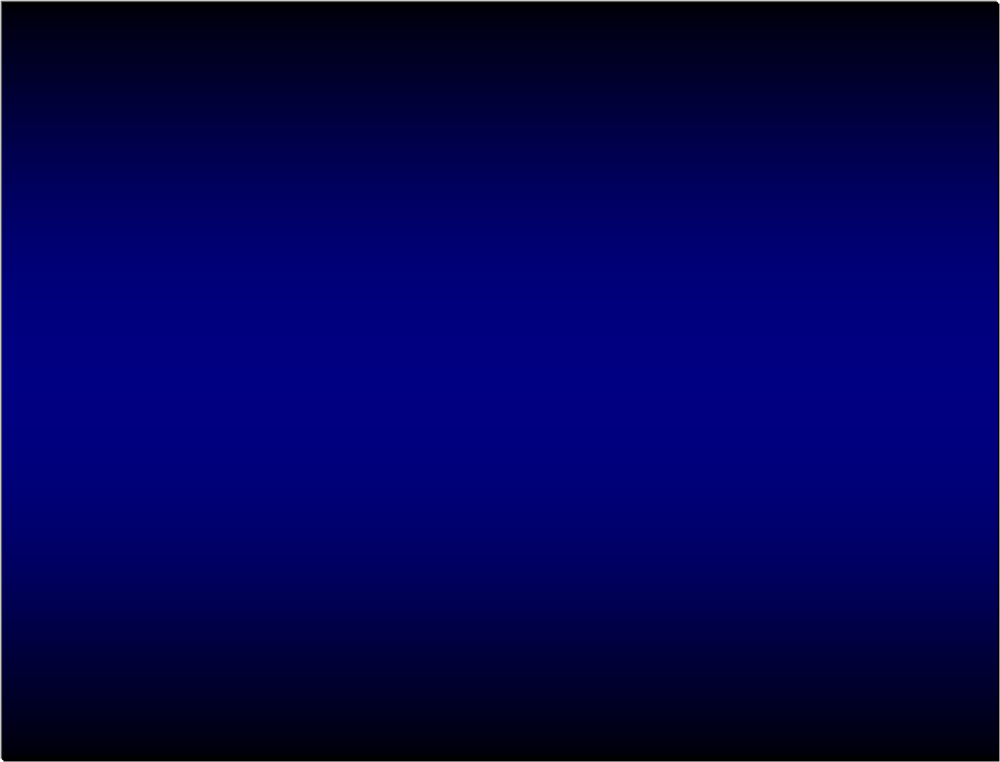
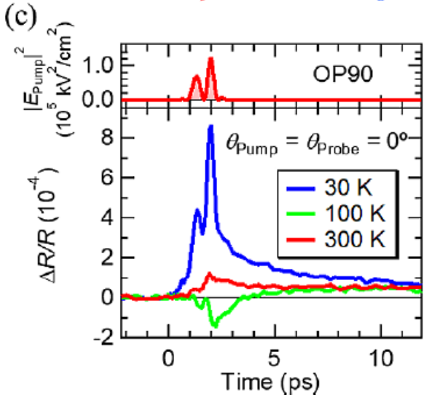
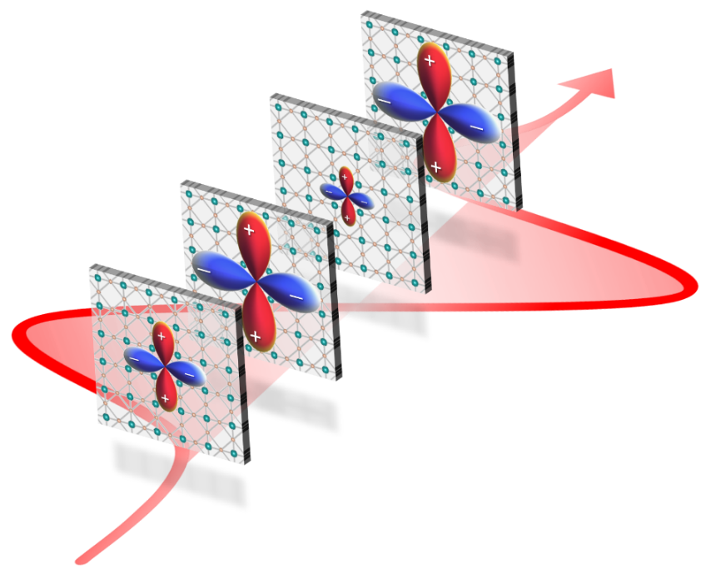
Higgs modes in a HTC cuprate
Experiment + theory on Bi2212
The present topological SC intimately related to Higgs mode excitations
→ an interesting possibility: topological SC enhanced by
resonantly exciting the Higgs

Slide 26

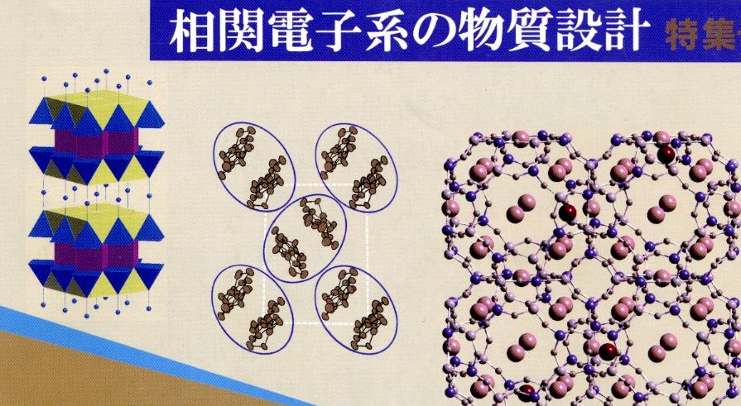
Design for correlated systems
＊Conventionally, materials design ← elements/crys str)
＊Design on t-axis
(in other words, design in 4D with the 4th dim = time)

Slide 27


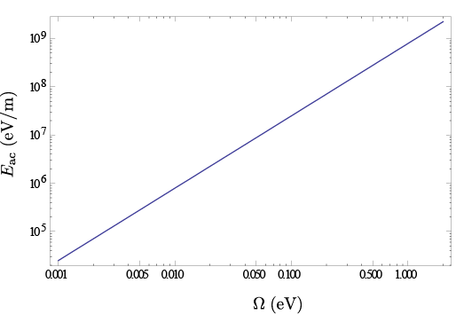
We can have intense enough laser for topological phases
FTI in graphene
(McIver et al, nat phys 2020)
Photo-induced insulator-metal tr
(Wall et al, Nat. Phys. 2010)
Floquet topological SC
(present proposal)for
typical HTC cuprates with
t ∼ 0.4 eV, ω ∼ U, a ∼ 3 Å
Laser field E (eV/m)
THz (pulse)
(Hirori et al; Watanabe et al)
Required for FTI with
topological gap ~ 0.1eV
Required intensity will be reduced by
(i) going to honeycomb/kagome,
(ii) lower ω
Laser frequency ω (eV)

Slide 28
Summary: Floquet engineering for topological many-body states
Magnetism in Mott insulator Superconductor
(from repulsion)
-
+
imaginary
(a) Floquet can make laser couple with gap function.
(b) Correlated hopping/chiral spin int contribute to topological SC.
Chiral (3-)spin interaction
Diagonal (2nd-neighbour) pairing → (d+id)-wave
''(1) Floquet, (2) topological & (3) strong-correlation engineering''

Slide 29
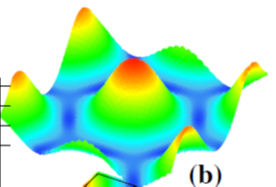
A comment: in equilibrium SC, enhanced SC can occur in
multi-bands [Mazziotti, ..., Bianconi, Europhys Lett 2021;
Ochi, ..., Aoki, PRR 2022; Yue, Aoki & Werner, PRB(L) 2022;
Chu, ..., Kaiser, Nat Comm 2023]
+CPL
and
flat-bands/vHs
[Aoki, J Supercond and Novel Mag 2020; Mazziotti, ..., Bianconi, PRB 2021;
Sayyad, ..., Aoki, J Phys Condens Matter 2023;
Lechermann, ..., Eremin, arXiv:2306.05121; Sakakibara, ..., Kuroki, arXiv:2306.06039]
→ A future work: Floquet topological engineering for these
Electronic nematicity enhances SC (almost doubles Tc)
in a frustrated (triangular) lattice (≈ TBG)
with [(d_{x2-y2} + s_{x2+y2})+ d_{xy} ] pairing
+ =

Slide 30
Future works also include:
* Competition with other phases
* Elaboration of heating effects
* Accurate treatments of the resonance
. . .
✔ Dissipation → non-equil steady states (NESS)
[Tsuji, Oka & Aoki, PRL (2009); Aoki et al, RMP (2014);
more recently, e.g., Ikeda & Sato, Sci Adv(2020)]
✔ Heating; relaxation dynamics:
* Relaxation in isolated systems in strong periodic driving occurs
on long time scales, with energy almost conserved in the prethermalisation.
[Mori et al, PRL (2016); Kuwahara et al, Ann Phys (2016);
Abanin et al, Comm Math Phys(2017)]
* Advances in numerical algorithm for relaxation dynamics
[Guerci, Capone & Lanata (arXiv:2303.09584)]
* Suppression of heating by multi-colour driving
(Murakami et al, arXiv:2301.10379)

Slide 31

How to observe d+id ?
* Chiral edge currents
Δ⁺ =
* Higgs mode in T-broken SC
(Poniatowski et al, Comm Phys 2022)
cos(η) dx²-y²
+ sin(η) dxy
Δ⁻ =
* Spectroscopies
Ω/2Δ₀
Quench-drive spectroscopy (simultaneous pump-probe
+ multicycle) for SC (Puviani, Haenel & Manske, PRB 2023)
pump pulse
multicycle
drive
delay time

Slide 32



Sota Kitamura, Takashi Oka Univ Tokyo
Sota Kitamura Univ Tokyo

