Slide 1


Int. Workshop“CORPES 2022”
online, 14 July 2022
Engineering superconducting and topological systems
in and out of equilibrium
Hideo Aoki
Dept Physics, Univ Tokyo, Japan
&
AIST, Tsukuba, Japan

Slide 2
Plan of the talk
Superconductivity Topological
(from repulsion)
Equilibrium
Incipient-band SC
* a new cuprate
* flat bands
Floquet topological insulator
Incipient-band SC
Non-equil
* Floquet topological d + id SC
Floquet-engineered SC

Slide 3
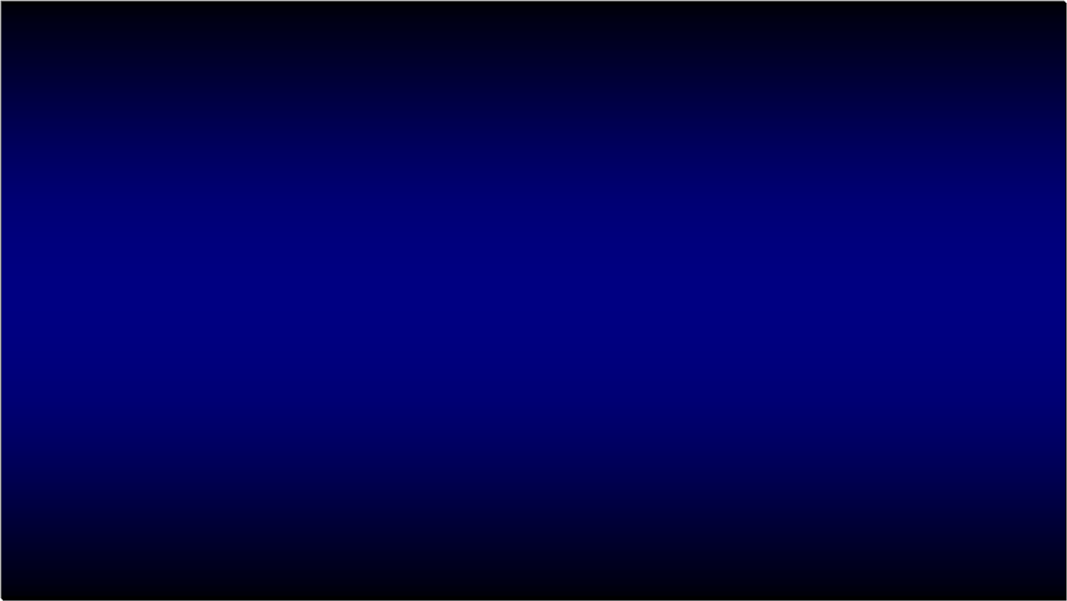
Good cuprates are one-band
--- Q: Is this always the case ?
An incipient band can favour SC
even for a cuprate theoretically.

Slide 4
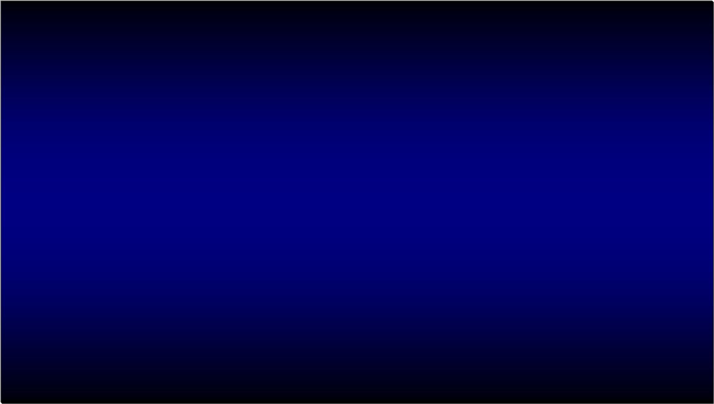

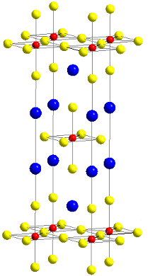
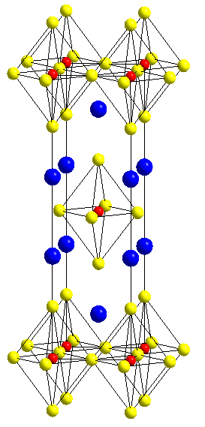
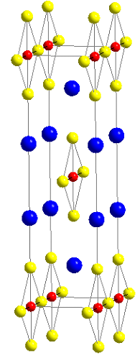
(Li et al, PNAS 2019)
High Tc in single-layer Ba₂CuO_{3+δ} δ ≈ 0.2 (≡ Ba₂CuO_{4-y} y = 1−δ ≈ 0.8)
Ba₂CuO_{3+δ}
Ba₂CuO₃
Ba₂CuO₄
≡ Ba₂CuO_{4-y}
oxygen depletion
oxygen depletion
fully occupied apical O
In-plane O vacancies
Cu-O plane
CuO-chain
octahedron
● Heavily hole-doped (p = 2δ ≈ 0.4/Cu)
Ba₂²⁺Cu^{2+p}O_{3+δ}, δ ≈ 0.2
● Heavily (40%) O-deficient Cu-O plane
inplane
apical
Ba₂CuO_{2(1-y/2)}O₂
a = 3.76 Å
c = 12.57 Å
a = 3.4954 Å
Various theoretical proposals for the el structure
(Maier, …, Scalapino, PRB 2019; Liu et al, PRMat 2019, …)
La₂CuO₄
a = 3.78 Å
c = 13.2 Å
b = 3.9057 Å
c = 12.68 Å
* Experimentally, a tetragonal structure suggested

Slide 5

Mother (undoped) compound: Ba₂CuO₃
(Yamazaki et al, PRR 2020)
(Ba₂CuO₃)₄ = Ba₈Cu₄O₁₂ = (Cu₄O₄) (Ba₂O₂)₄
Planar Apex
orbital 2(dz2)
Bird's eye view
O (in-plane)
O (apex)
Cu
orbital 1(dx2-y2)
gap function(FLEX)
Δ11 Δ22 Δ12
intra-orbital extended s inter-o d

Slide 6

Tc dome
(Yamazaki et al, PRR 2020)
comes from an
“incipient band”
ΔE
intra-orbital s-wave;
inter-orbital d-wave
Usual one-band d-wave

Slide 7
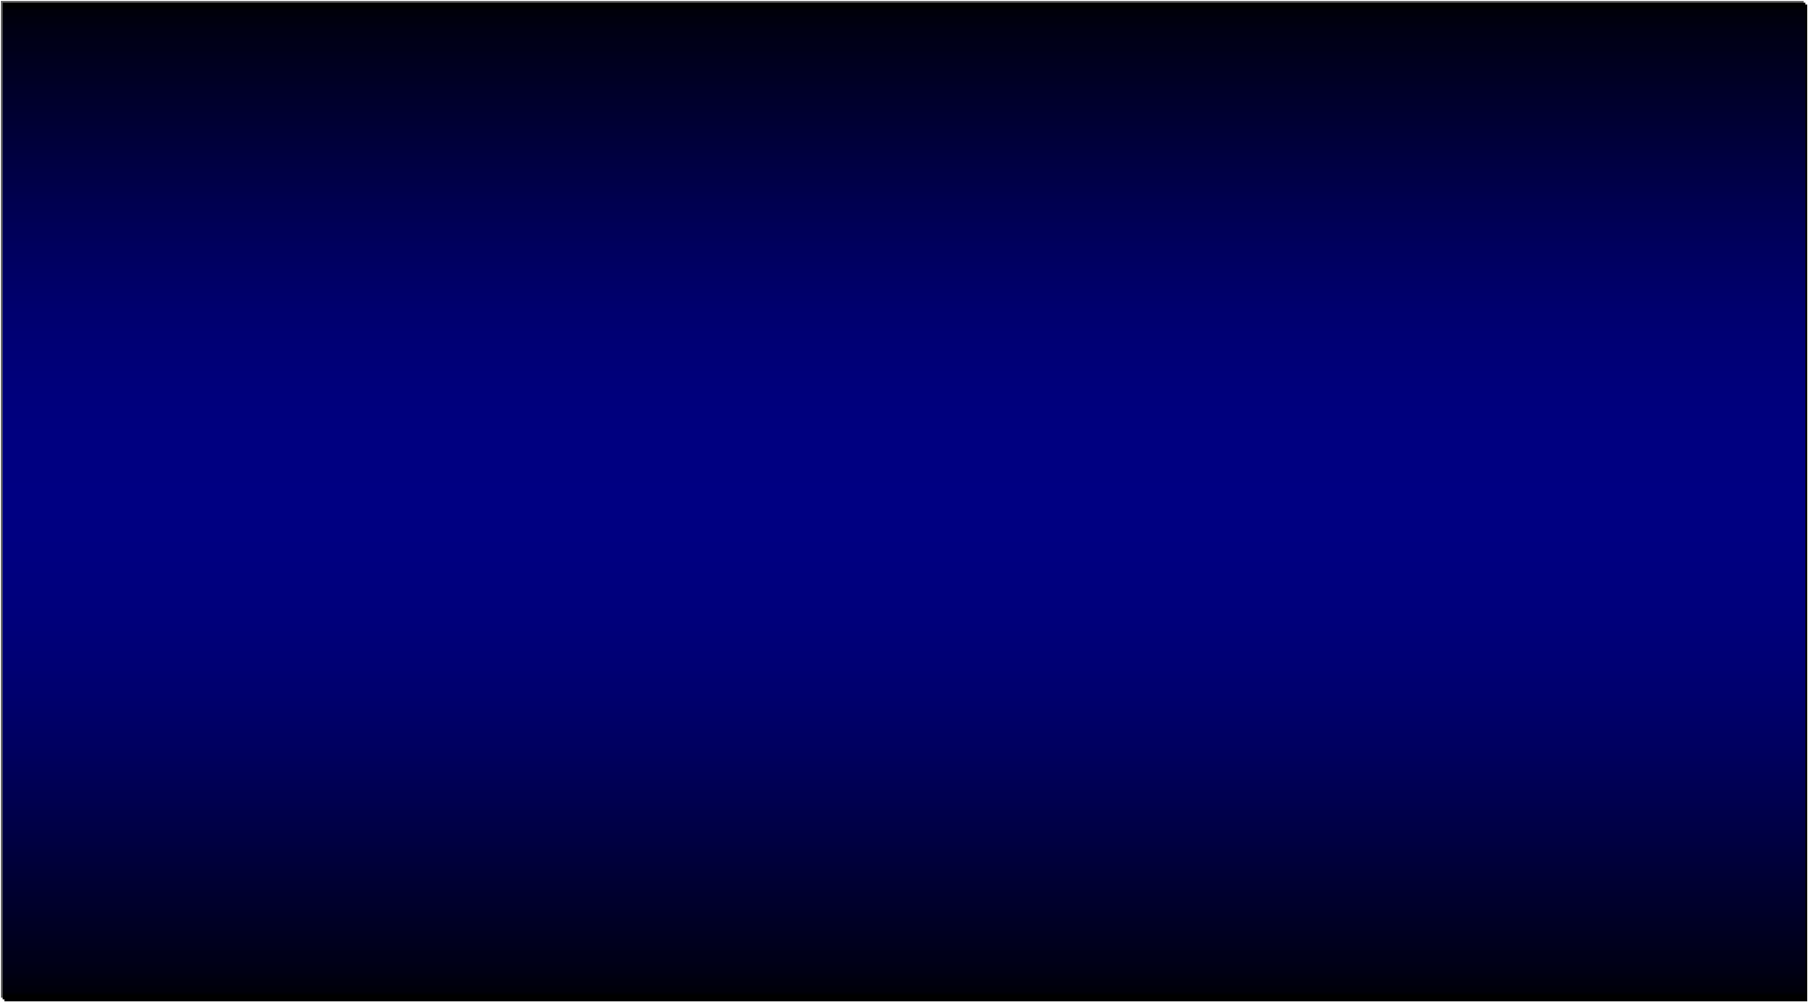
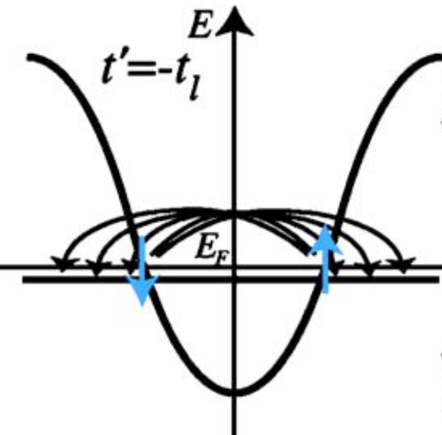
Incipient (close to, but away from E _{F}) bands
as in FeSe (Qian et al, PRL 2011; …)
+
Originally, the concept of
"incipient bands" introduced by
Kuroki et al, PRB 2005
E _{F}
+
+
+
-
incipient s±
The notion works even in the strong-U regime:
(DCA: Maier, …, Scalapino, PRB 2019;
Karakuzu, ..., Maier, PRB 2021;
VMC: Kato & Kuroki, PRR 2020)
(ARPES: Rinott et al, Sci Adv 2017)

Slide 8

SC in incipient flat-bands/flat portions
2-band
1-band
E_{F}
incipient
E_{F}
incipient
* Higher Tc in both cases

Slide 9

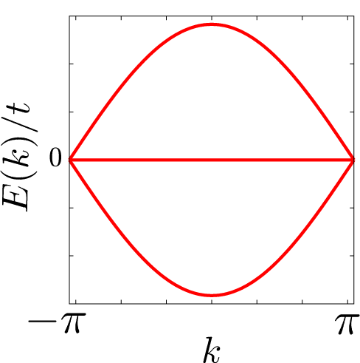
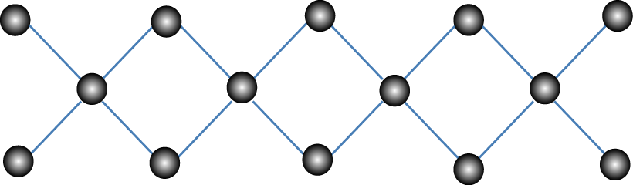
Repulsive Hubbard model on diamond chain
(a simplest possible 1D flat-b)
(Kobayashi et al, PRB 2016)
non-orthogonalisable Wannier

Slide 10
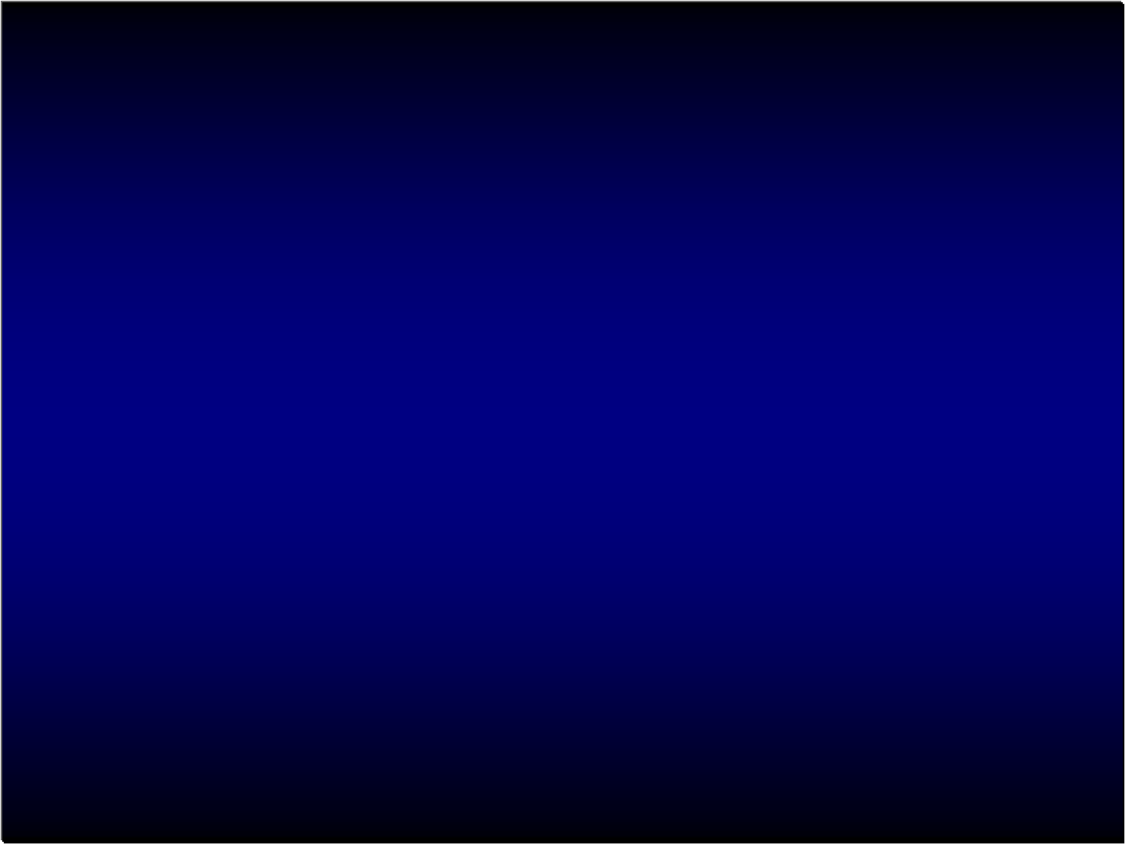
Phase diagram
(DMRG; Kobayashi et al, PRB 2016)
0
1/3
1/2
2/3
1
Incipient flat band
→SC adjacent to a
topological phase
Flat-b F
TI
band filling
E_{F}

Slide 11

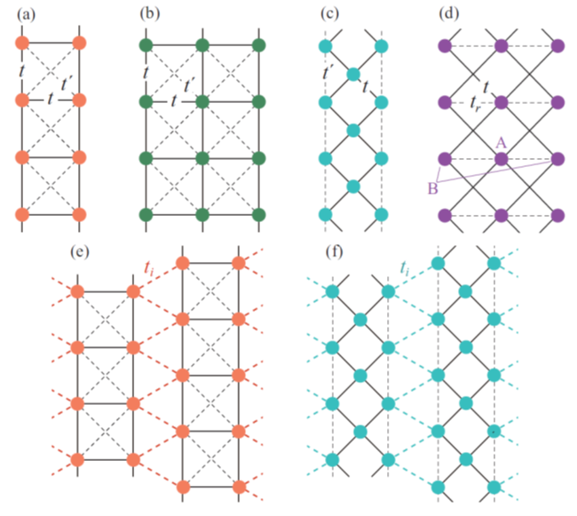
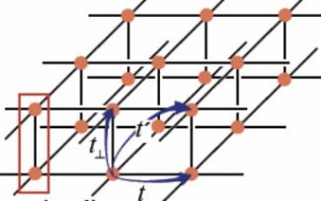
Variouos flat-band models
(Matsumoto, Ogura & Kuroki, PRB 2018; JPSJ 2020)
μ - E_{flat}
E_{F}
Spin susceptibility (ω)
low-E region:
pair breaking
Tc ~ 0.08t
(cf. cuprates' Tc ~ 0.03t)
higher-E region:
pair enhancing
What determines the dip-width ?
✔ Low-E spin fluctuations → degrade SC (μ shouldn't be too close to E _{flat})
[For ordinary d- and s-wave SCs, this has been shown by
Millis-Sachdev-Varma(PRB 1988) → present case is its s± version]

Slide 12
2-band vs 1-band flat-band SC
2-band
1-band
E_{F}

Slide 13
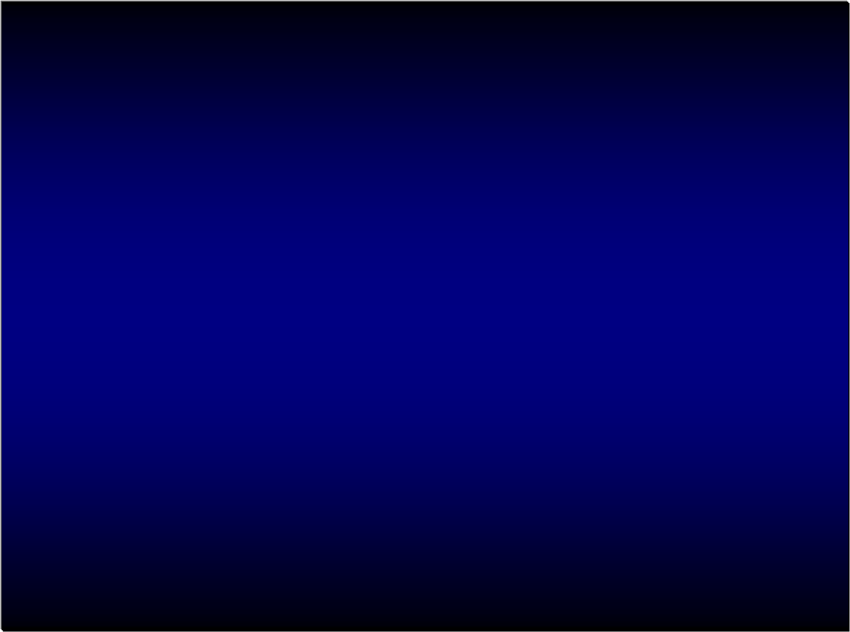
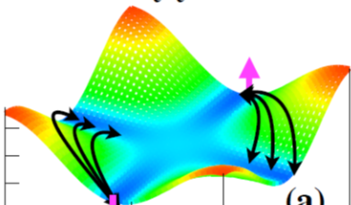
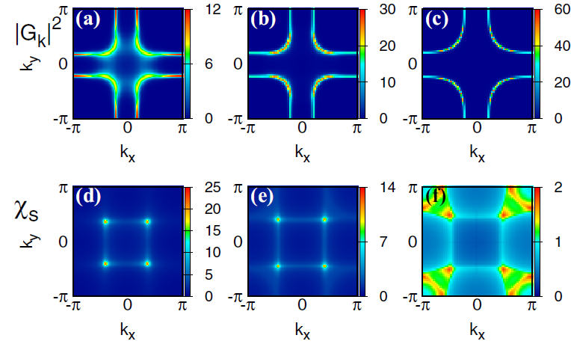
Partially-flat band
t'∼ -0.5t (a kind of frustration)
Green's function
t
t'
χ_{spin}
(Sayyad et al, PRB 2020)

Slide 14
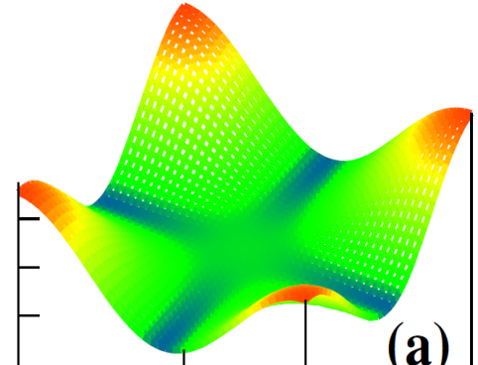
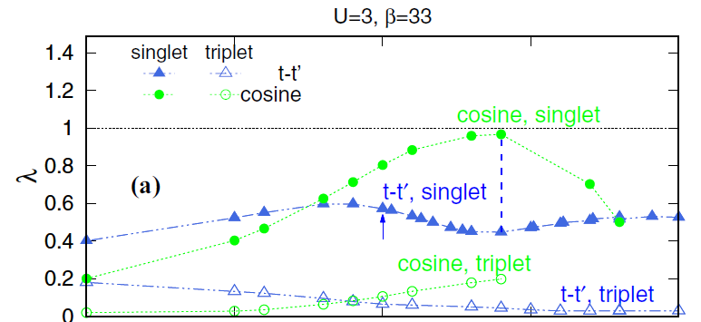
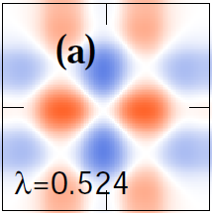
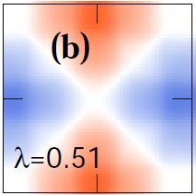
Tc dome
(Sayyad et al, PRB 2020)
t-t' model
Method:
FLEX+DMFT,
DQMC
k-space
t-t', singlet
Eliashberg
real-space
unusually extended pair

Slide 15

Why frustrated t-t' model?
A hint: t-t'-t"-U (≫t) model on a square lattice
(Delannoy, ..., Tremblay, PRB 2009)
Half-filled t-U (≫ t) model →(1/U) expansion up to O(1/U³)
→
→ inclusion of t', t" makes it even more complicated
Heisenberg AF
4-site ring exchanges
My guess:
Ring-exchange interactions tend
to be enhanced in flat bands

Slide 16
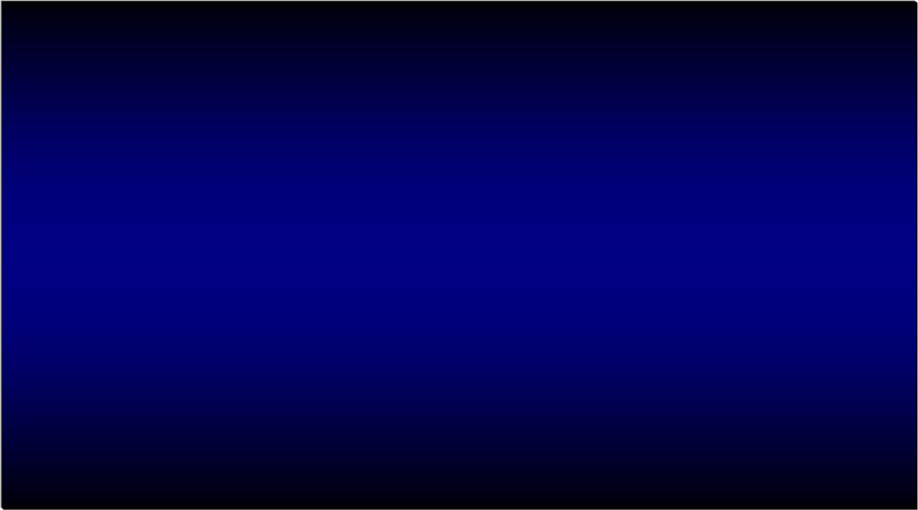
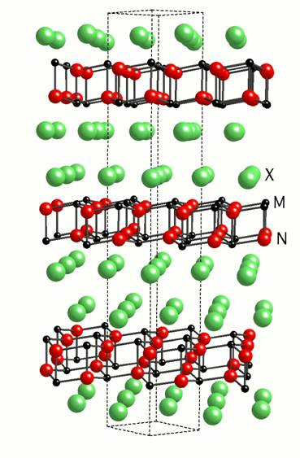
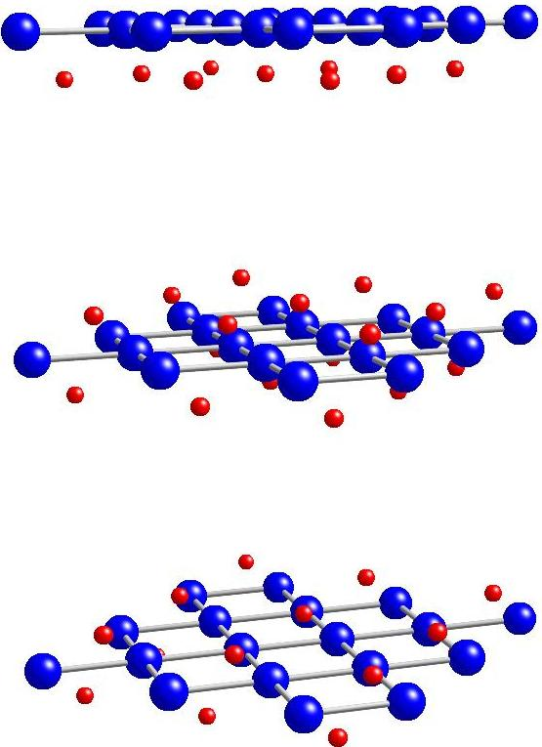
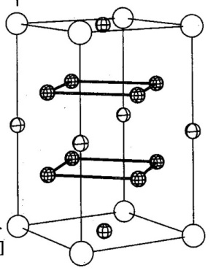
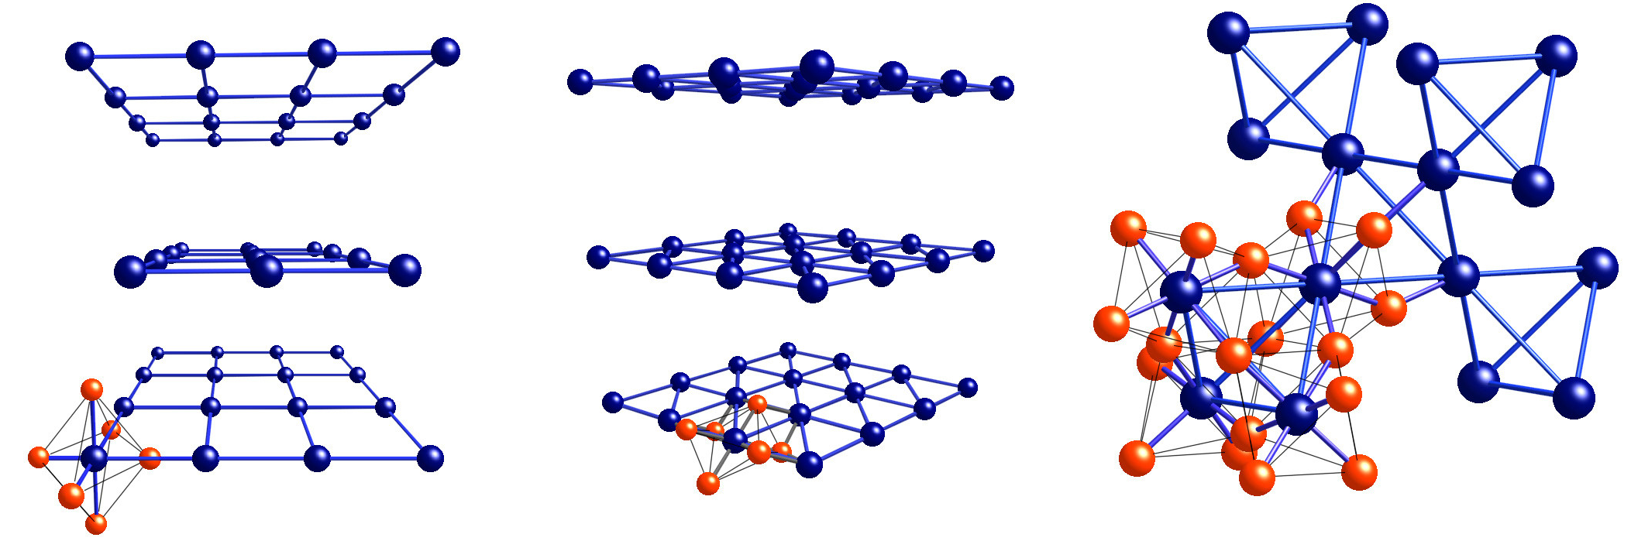
Dimensionality-dependence:
Usually, SC from el-el repulsion works much better in 2D than in 3D
q2D 3D
Orange: Large spin-fluct mediated
pairing int.
+
-
+
-
-
+
>
-
-
+
Q_{z}
+
k_{y}
k_{y}
+
-
k_{z}
Q_{x}
AF
Q_{x}
AF
(Arita et al, 1999;
Monthoux & Lonzarich, 1999)
Cu, Ru compounds Co compound Hf compound Ce compound Fe compound

Slide 17
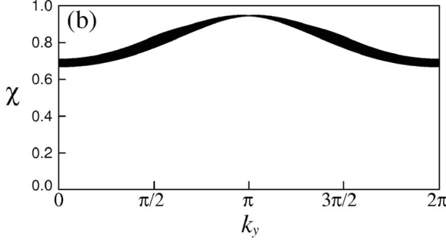
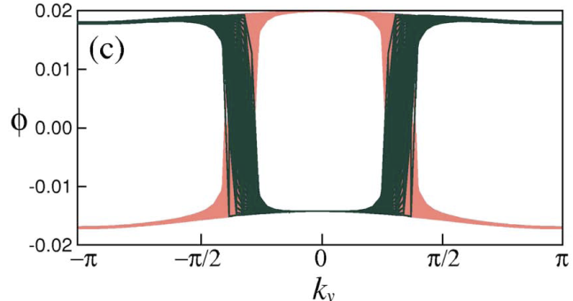

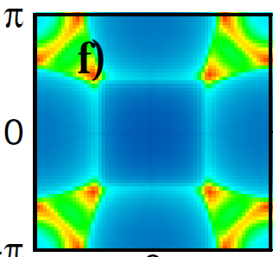
Flat-band SC has totally different dim-dep
1D
Narrow-wide band system(Kuroki et al, PRB 2005)
dispersive band
+
s pairing
over entire Bz
-
spin susc featureless
flat band
2D
Partially-flat band(Sayyad et al, PRB 2020)
χ_{s} broad in k gap f mom distr
3D
Specialty of the flat-band SC
(beyond the nesting physics):
→ 3D as good as 2D
(evades Arita's & Lonzarich's theorem)
Q_{z}
Q_{y}
Q_{x}

Slide 18
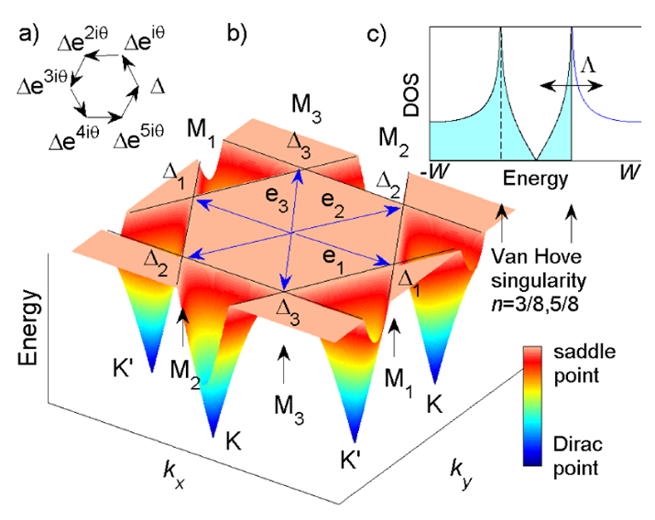

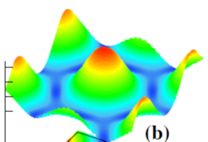
v_{group} = 0 at a point: van Hove sing. → topological SC (d+id, etc)
Honeycomb with E_{F} ∼ v Hove TBG (Liu et al, PRL 2018) kagome (Wu et al, PRL 2021)
(Nandkishore et al, nat phy 2012)
d+id
d+id
+ i
v_{group} = 0 in finite areas in flat bands
Square Triangular
Electronic nematicity
→ enhances SC
(Sayyad et al, arXiv:2110.14268)

Slide 19
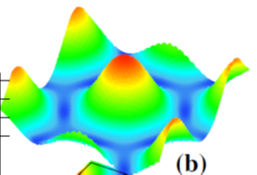
A question: Can electronic nematicity enhance SC?
● Usually, no, or only small (2nd-order) effects
(e.g., Kitatani, Tsuji & Aoki, PRB 2017)
● In triangular lattice
* frustration
→ enhances nematicity
→ concomitantly enhances SC
(almost doubles Tc, a 1st-order effect)
(Sayyad et al, arXiv:2110.14268, now
published in J Phys Condensed Matter 2023)
t' = 0.15

Slide 20
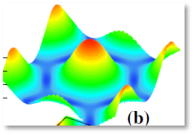
(FLEX+DMFT, Sayyad et al, JPCM 2023)
n = 0.9 n = 1.0 n = 1.1
Green's function
Nematic (C6 symmetry → C2)
Momentum distr
Spectral f A(k, ω)
χ_{spin}

Slide 21


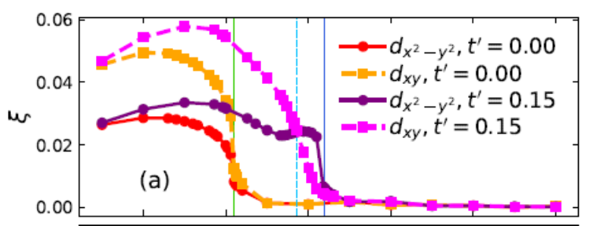
(Square) t'=0.5
(Triangular) t'=0.15
(Sayyad et al, JPCM 2023)
Nematicity allowed
Eliashberg λ
t-t', singlet
Nematicity forbidden
(Sayyad et al, PRB 2020)
Nematicity ξ

Slide 22

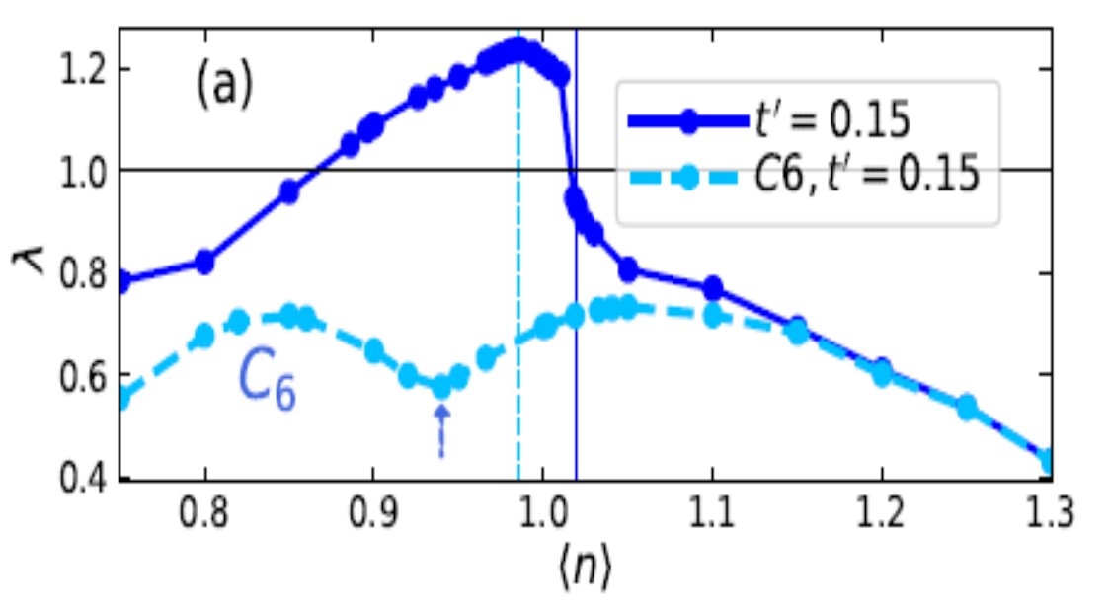
(Sayyad et al, JPCM 2023)
Gap function
Pairing interaction, hence λ, significantly enhanced
n =0.9 n = 1.0 n = 1.1
dx²-y²
Cf. tetragonal lattice,
where 1st-order effect of nematicity
on λ identically vanishes
in C₆ point-group irred rep
(y² in C₂ (nematic phase) point-gr)

Slide 23
Plan of the talk
Superconductivity Topological
(from repulsion)
Equilibrium
Incipient-band SC
* a new cuprate
* flat bands
Floquet topological insulator
Non-equil

Slide 24
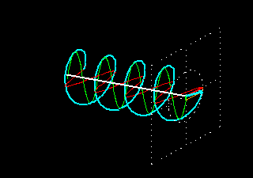

Floquet topological insulator
(Oka & Aoki, PRB 2009)
Experimental detection of FTI in graphene
(McIver et al, 2020)
B = 0
topological gap opens
dynamically
Hall current
Chern density
Quantum anomalous Hall effect (QHE in B=0)

Slide 25
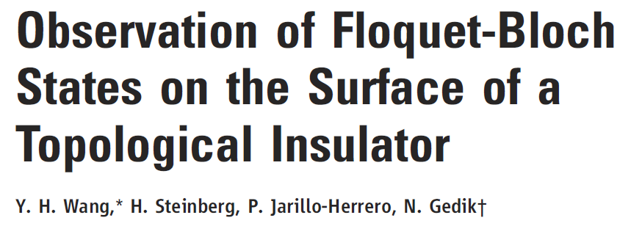
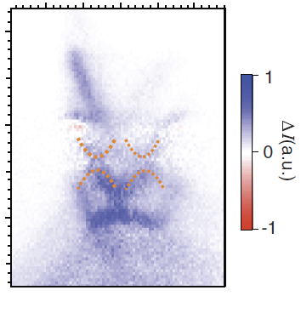


First detection of FTI: surface of 3D TI
(see also: Mahmood, …,
Gedik, nature phys 2016)
(MIT)

Slide 26
Plan of the talk
Superconductivity Topological
(from repulsion)
Equilibrium
Incipient-band SC
* a new cuprate
* flat bands
Floquet topological insulator
* Floquet topological d + id SC
(in a t-t' model)
Non-equil

Slide 27
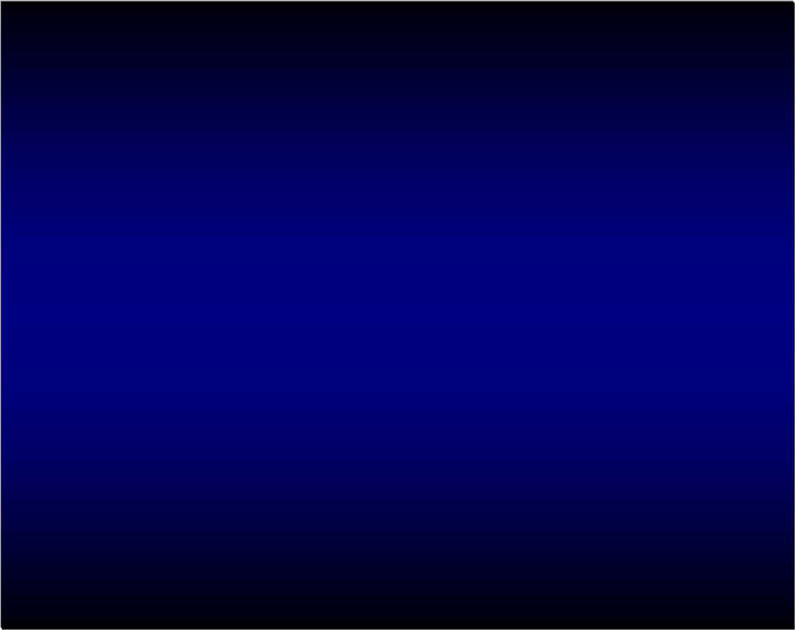
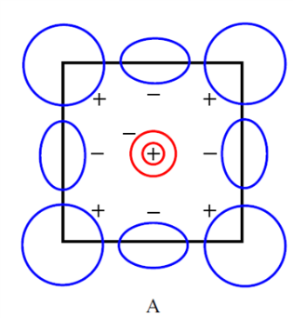
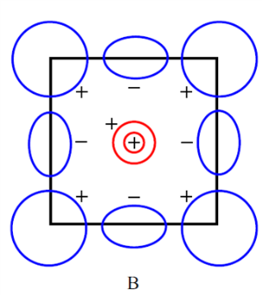
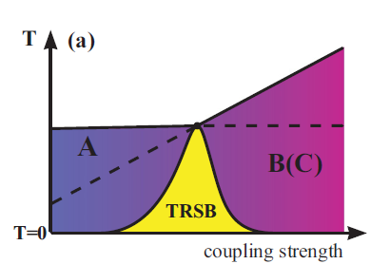
T-broken SC ← usually from coexisting pairing symmetries
in equilibrium
- eg, proposed for iron-based SCs
-
An entirely different (dynamical) way ― Floquet
-
+
+
s+- d
s+-(A) s+-(B)
T
T
Lee, Zhang & Wu, PRL 2009 for "1111";
Fernandes & Millis, PRL 2013 for "122"
Ahn et al, PRB 2014 for LiFeAs

Slide 28
Dirac (one-body)
Strongly-correlated systems
real space
graphene
d-wave SC
Mott insulator
d+id wave SC
FTI
chiral spin states
This is not so simple,
because laser doesn't couple with gap function
k space
(Oka & Aoki, PRB 2009)
(Kitamura, Oka & Aoki, PRB 2017;
Claassen et al, nat comm 2017)
(Kitamura & Aoki, Comm Phys 2022)

Slide 29
Go to strong-coupling regime
to realise d-wave SC + CPL → "Floquet topological (d_{x2-y2} + id_{xy})SC"
(Kitamura & Aoki, Comm Phys 2022)
Repulsive Hubbard model + CPL
on a square lattice
t << U → * No CPL → t-J model [strong-coupl. (Schrieffer-Wolff)expansion]
* Under CPL → Floquet extension (for t << ω < U )
t
t'
~
photon-induced correlated hopping
photon-modified kinetic exchange
Floquet renormalised hopping
photon-induced chiral
spin coupling

Slide 30
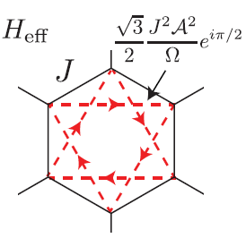
One-body problem
Haldane's model
honeycomb
t
+ =
this is why graphene accommodates FTI
Strongly-correlated case
square lattice already
accommodates topology
square
no cancellation
cancellation
(Kitamura & Aoki, Comm Phys 2022)

Slide 31
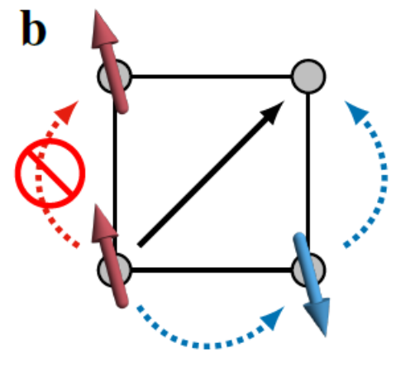

Floquet Hamiltonian in Bogoliubov-de Gennes form
(Mean-field analysis for H _{Floquet} with Gutzwiller projection,
Kitamura & Aoki, Comm Phys 2022)
t
δ: doping, g=2/(1+ δ)
t'
acquires a d_{xy} component ∝ sin(k_{x}) sin(k_{y}) involving
two-step correlated hopping
chiral spin-coupling
→ dx²-y² + idxy

Slide 32

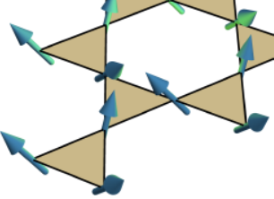
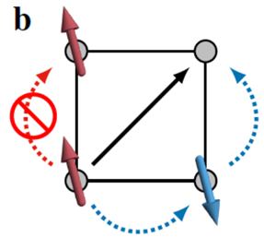
Chiral spin-coupling
Two-step correlated hopping
Series of "ω-U" resonances
(t' = -0.2t, U = 12t, δ = 0.2)
laser field intensity
laser frequency
(Kitamura & Aoki, Comm Phys 2022)

Slide 33
Gap function
amplitude phase
=
topological gap
(Kitamura & Aoki, Comm Phys 2022)

Slide 34
Photon-induced interactions behave as:
two-step correlated hopping
γ: expression in terms of J₂(Ea/ω)×(ω-U resonance factor),
peaked around E ∼ 2ω/a as a f of E, diverges for ω → 0 or U/2
☺ γ is significant even in low-ω regime, which helps required E ∝ ω
Taylor-expand in E → γ ∼ t t' E⁴ × (function of ω, U )
chiral spin-coupling
J_{χ}: expression in terms of J_{m}(Ea/ω)'s×(ω-U resonance factor),
☺ diverges for ω → U
Taylor-expand in E → J_{χ} ~ (t t' )² E⁴ × (function of ω, U )
t-t' model needed
kinetic exchange (photon-assisted)
J: strongly-enhanced AF when slightly red-detuned from U/2 or U
For an optimal E , idxy component = i 0.3t sin(k_{x}) sin(k_{y}),
☺ remarkably ≈ dx²-y² = 0.7t [cos(k_{x}) -cos(k_{y})] → large topological gap
(Kitamura & Aoki, Comm Phys 2022)

Slide 35

"Tc dome" against laser intensity for the (d + id) SC
|Δ|
Im Δ
CPL-incuded SC
---:
T ^{eff} in Floquet Hamlitonian
topological
temperature
laser field intensity
(Kitamura & Aoki, Comm Phys 2022)

Slide 36
Quench dynamics
confirms this
|Δ|
Im Δ
oscillation = Higgs A_{2g} mode
nonequilibrium-induced SC
|Δ|
Im Δ
Switch on
the laser
oscillation = Higgs A_{2g} mode
Switch on
the laser
time scale for damped osc ∼ 1/(gap f)
(Kitamura & Aoki, Comm Phys 2022)

Slide 37
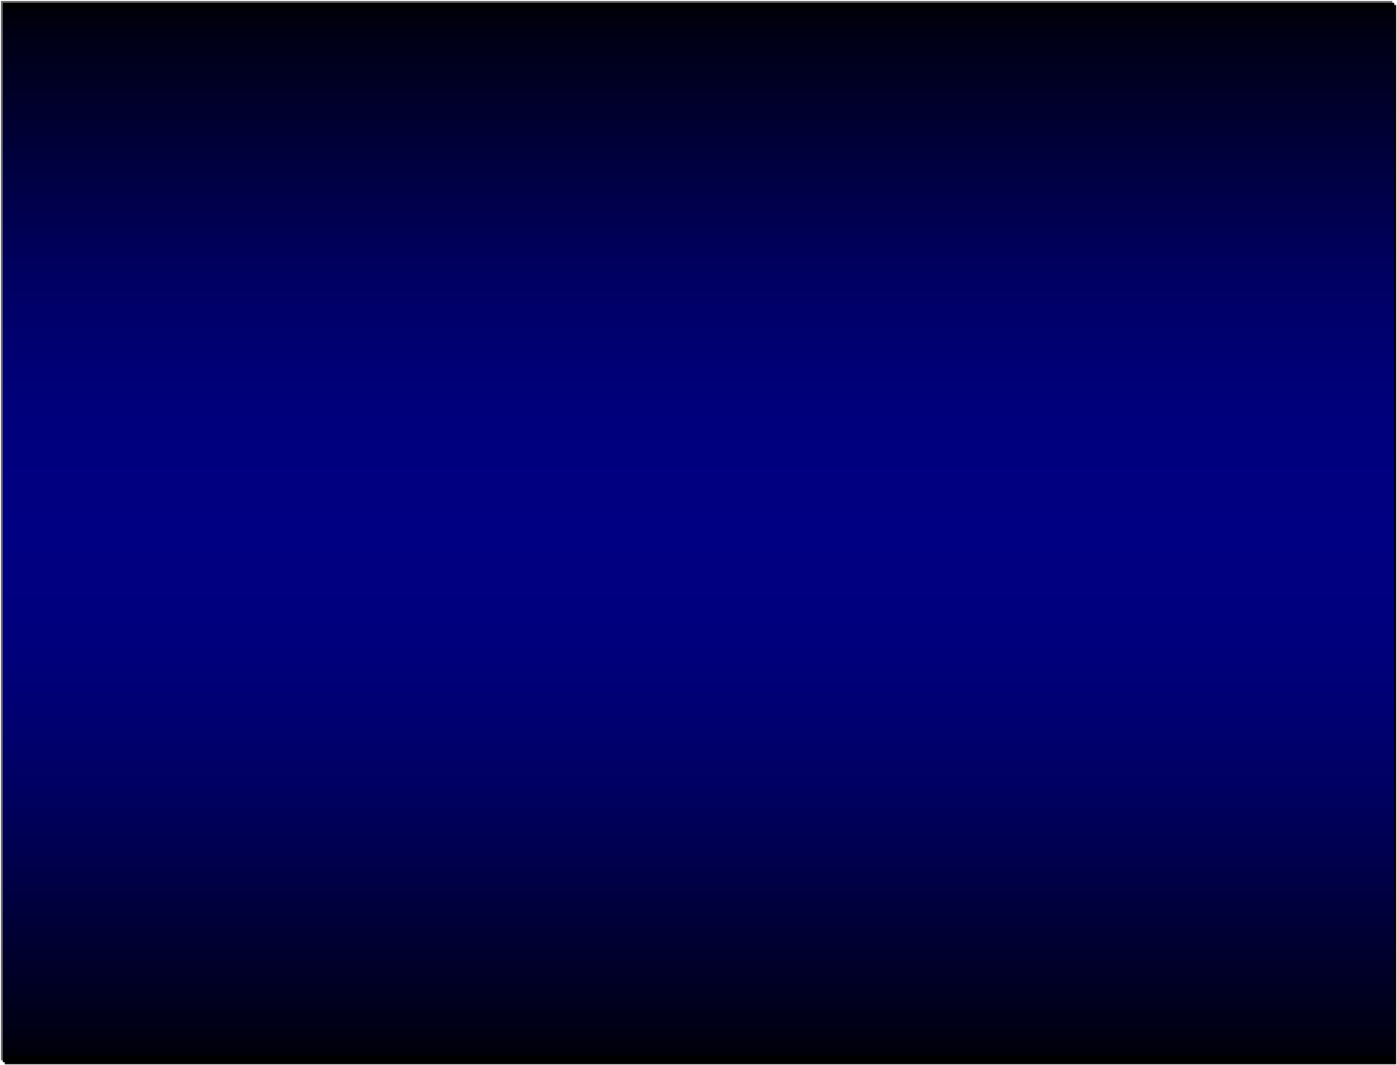
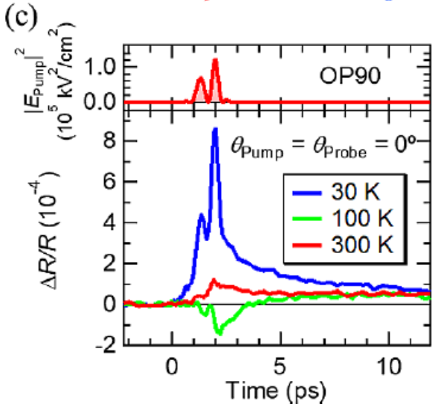
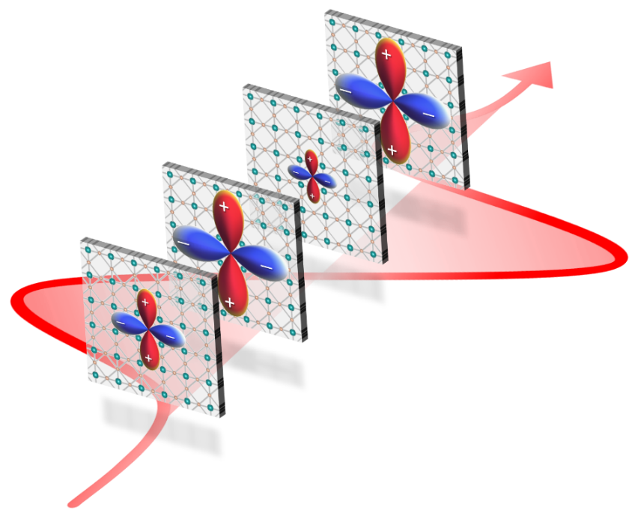
Higgs modes in a HTC cuprate
Experiment + theory on Bi2212
The present topological SC intimately related to Higgs mode excitations
→ an interesting possibility: topological SC enhanced by
resonantly exciting the Higgs

Slide 38

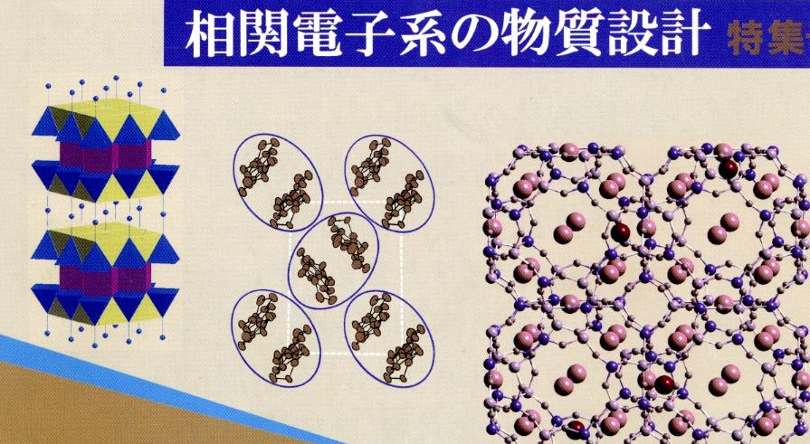
Design for correlated systems
＊Usually, materials design (elements/crys str)
＊Design on t-axis
(in other words, design in 4D with the 4th dim = time)

Slide 39

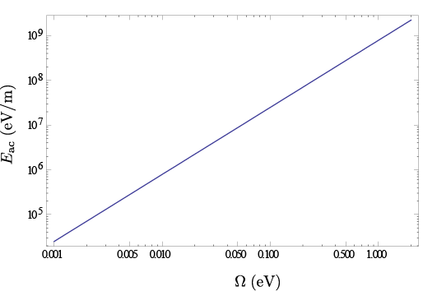
We can have intense enough laser for topological phases
FTI in graphene
(McIver et al, nat phys 2020)
Photo-induced insulator-metal tr
(Wall et al, Nat. Phys. 2010)
Floquet topological SC
(present proposal)for
typical cuprates with
t ∼ 0.4 eV, ω ∼ U, a ∼ 3 Å
Laser field E (eV/m)
THz (pulse)
(Hirori et al; Watanabe et al)
Required for FTI with
topological gap ~ 0.1eV
Required intensity reduced by
(i) going to honeycomb/kagome,
(ii) lower ω
Laser frequency ω (eV)

Slide 40
Summary: take-home messages
Superconductivity / Topological
Equilibrium
✔ Incipient-band SC
* Effective in flat bands
* Possibly work even in a cuprate
* Nematicity can enhance SC
✔ Topological d + id SC
* realisable in a t-t' model by CPL with realistic intensities
Non-equil
These indeed harbour unique opportunities
giving a prospect of quantum phases
Future works:
Competition with other phases

Slide 41






Kimihiro Yamazaki, Masayuki Ochi, Daisuke Ogura, Kazuhiko Kuroki Osaka Univ
Hiroshi Eisaki AIST
Shinichi Uchida AIST/CAS
Sharareh Sayyad Univ Tokyo, now at Erlangen
Abolhassan Vaezi, Edwin Huang Stanford
Mohammad-Sadegh Vaezi Pasargad Institute
Zohar Nussinov Washington Univ
Motoharu Kitatani TU Wien, now at Riken
Sota Kitamura Univ Tokyo

